Slide 1

Web Data Collection
Chapter 2

Slide 2
Agenda
What is a web Crawler and how does it work?
What is a Web Scrapper and How does it work?
How a Search Engine Works
Crawling and Indexing Techniques
Handling Structured and Unstructured Data on the Web

Slide 3
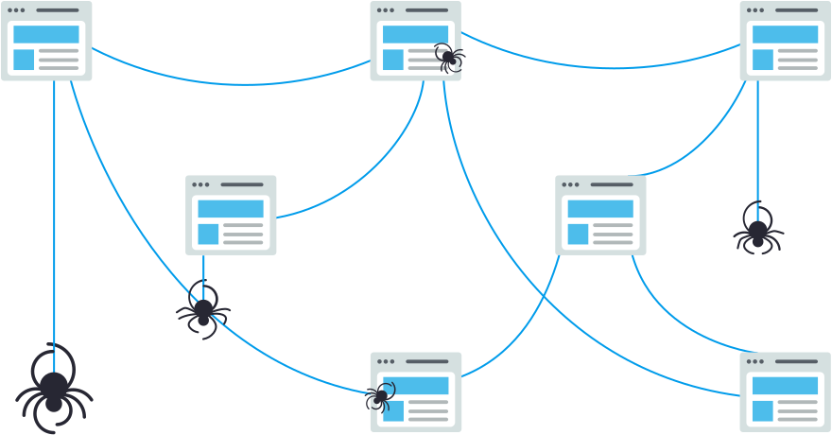
What is Web Crawling?
Web crawling is the process of indexing data on web pages by using a program or automated script. These automated scripts or programs are known by multiple names, including web crawler, spider, spider bot, and often shortened to crawler.
Crawling, indexing and Ranking are fundamental processes in search engine operations. These processes are crucial for search engines to retrieve and organize information from the vast expanse of the internet.
Notes:
Sample: https://github.com/BruceDone/awesome-crawler?tab=readme-ov-file#javascript

Slide 4
Two functions of a Web Crawler
Systematically browsing the web to index content for search engines. Web crawlers copy pages for processing by a search engine, which indexes the downloaded pages for easier retrieval so that users can get search results faster. This was the original meaning of web crawler.
Automatically retrieving content from any web page. This is more commonly called web scraping. This meaning of web crawler came about as companies other than search engines started using web scrapers to retrieve web information. For example, e-commerce companies rely on their competitors’ prices for dynamic pricing.

Slide 5
How does a web crawler work?
Web crawlers start their crawling process by downloading the website’s robot.txt. The file includes sitemaps that list the URLs that the search engine can crawl.
Once web crawlers start crawling a page, they discover new pages via hyperlinks.
Crawlers add newly discovered URLs to the crawl queue so that they can be crawled later if they are interesting to be crawled for the crawler’s developer.
Thanks to this flow, web crawlers can index every single page that is connected to others.

Slide 6
The Process of Web Crawling
Discovery
Crawling
Fetching
Rendering
Indexing

Slide 7
How often should we crawl?
It depends on change frequency of the content and we need to look at the cost as well

Slide 8
Search Engine Indexing
Search engines process and store information they find in an index, a huge database of all the content they’ve discovered and deem good enough to serve up to searchers.
Search engines have two main jobs:
Crawling the web to discover content;
Indexing that content so that it can be served up to searchers who are looking for information.

Slide 9
robot.txt
After arriving at a website but before spidering it, the search crawler will look for a robots.txt file.
If it finds one, the crawler will read that file first before continuing through the page.
Because the robots.txt file contains information about how the search engine should crawl, the information found there will instruct further crawler action on this particular site.
If the robots.txt file does not contain any directives that disallow a user-agent’s activity (or if the site doesn’t have a robots.txt file), it will proceed to crawl other information on the site.
Notes:
https://moz.com/learn/seo/robotstxt

Slide 10
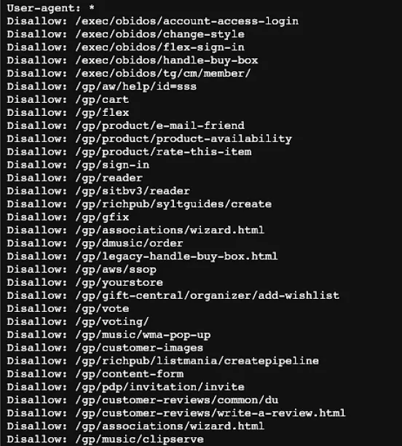

Slide 11
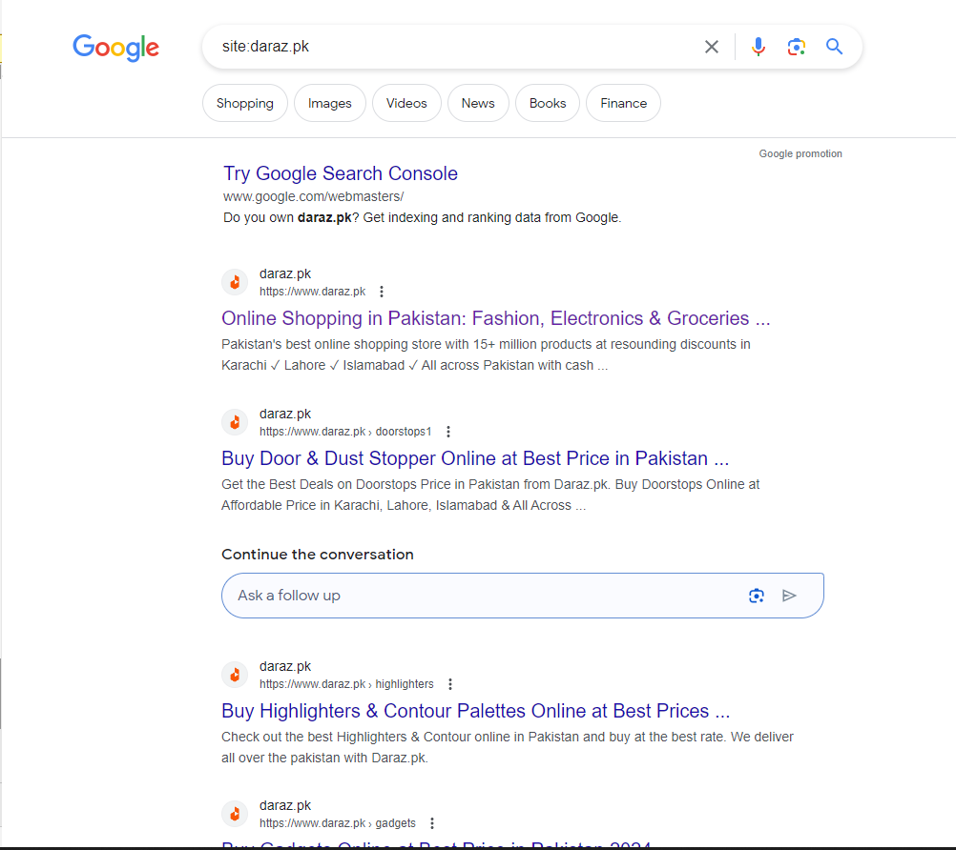
Search engine ranking
When someone performs a search, search engines scour their index for highly relevant content and then orders that content in the hopes of solving the searcher's query. This ordering of search results by relevance is known as ranking. In general, you can assume that the higher a website is ranked, the more relevant the search engine believes that site is to the query.

Slide 12
Google Search Console
With this tool, you can submit sitemaps for your site and monitor how many submitted pages have actually been added to Google's index, among other things.
If you're not showing up anywhere in the search results, there are a few possible reasons why:
Your site is brand new and hasn't been crawled yet.
Your site isn't linked to from any external websites.
Your site's navigation makes it hard for a robot to crawl it effectively.
Your site contains some basic code called crawler directives that is blocking search engines.
Your site has been penalized by Google for spammy tactics.

Slide 13
Web Scrapping
Basics
Selectors
Id, class, tag etc
Xpath
Testing vs Scrapping
Chrome Extensions
JS Solutions
Excel (Local storage)
Google Sheet

Slide 14
Handling data on the web
Structured data
For structured data like databases or well-defined formats (JSON, XML), you can use APIs or web scraping libraries like BeautifulSoup (Python) or Scrapy to extract the data.
APIs provide a structured way to access data from web services, making it easier to integrate into your application.
JSON and XML parsing libraries can help in extracting and processing structured data from APIs or web pages.

Slide 15
Handling data on the web
Unstructured Data
For unstructured data such as text, images, or videos, natural language processing (NLP) and computer vision techniques are useful.
NLP libraries like NLTK (Python), spaCy, or Transformers can be used to extract insights, sentiment analysis, named entity recognition, etc., from textual data.
Computer vision libraries like OpenCV or TensorFlow can help in analyzing images or videos, extracting features, object detection, etc.

Slide 16
Steps after acquiring data
Data Cleaning and Preprocessing:
Both structured and unstructured data may require cleaning and preprocessing before analysis. This involves handling missing values, removing duplicates, standardizing formats, etc.
Storage:
Store the extracted data in a suitable format depending on your needs. For structured data, databases like MySQL, PostgreSQL, or NoSQL databases like MongoDB are commonly used. For unstructured data, file systems or object storage solutions like Amazon S3 may be appropriate.
Analysis and Visualization:
Analyze the data using statistical methods, machine learning algorithms, or other analytical techniques depending on your objectives. Visualize the results using libraries like Matplotlib, Seaborn, or Plotly for structured data, and tools like D3.js or Matplotlib for unstructured data visualization.
Automation and Monitoring:
Implement automation scripts or workflows to regularly fetch and process new data.
Monitor data sources for changes or updates and adjust your scraping or extraction pipelines accordingly.

